Slide 1
Software Quality Assurance and Testing
Lecture -09
Harish Aggarwal

Slide 2
Re-Cap
Lecture - 01
Definitions – S/W Quality, S/W Quality Assurance
Importance of QA
Causes of Defects
Business Models in S/W
S/W Cost, Quality Cost
Quality culture
Lecture - 02
Software Quality Models
McCall, IEEE 1061, ISO 25000 Series
Quality Requirements
Quality of Requirements
Frameworks
ISO/IEC/IEEE 12207 - Software Life Cycle Processes
Lecture - 03
Frameworks
CMMI-Development
ITIL Framework
Other Frameworks
Lecture - 04
ISO 25010 – Quality Attributes
Functional Suitability, Performance Efficiency, Compatibility, Usability, Reliability, Security, Maintainability, Portability
Lecture - 05
Software Testing Fundamentals
Software Verification and Validation
Types of Testing - Black Box, White Box Testing
Test Levels and Types –
Unit, Integration, System Testing

Slide 3
Re-Cap
Lecture - 06
Test Design Techniques
Combinatorial Testing
Boundary Value Analysis
Equivalence Class Partitioning
Lecture - 07
Test Methodology
Decision Table Testing
Test Execution Process
Test Case Design
Automated Testing
Alpha and Beta Site Testing
Regression Testing Strategies
Lecture - 08
Revision

Slide 4
Agenda
Reviews
Informal Reviews
Personal Review
Peer Reviews
Formal Reviews
Walkthrough
Inspection Review
Audit
Types of Audits (Internal, Third Party)
Project Assessment and Control Process
Corrective Actions

Slide 5
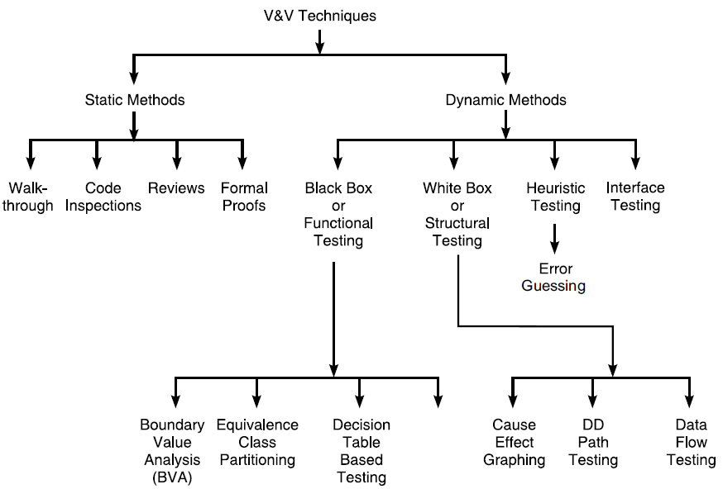
Reviews

Slide 6
Definitions
IEEE Standard for Software Reviews and Audits [IEEE 1028]
Review : A process or meeting during which a software product, set of software products, or a software process is presented to project personnel, managers, users, customers, user representatives, auditors or other interested parties for examination, comment or approval [IEEE 1028]
Review : A process or meeting during which a work product, or set of work products, is presented to project personnel, managers, users, customers, or other interested parties for comment or approval. [ISO 24765]
Management Review: A systematic evaluation of a software product or process performed by or on behalf of management that monitors progress, determines the status of plans and schedules, confirms requirements and their system allocation, or evaluates the effectiveness of management approaches used to achieve fitness for purpose [IEEE 1028]

Slide 7
Standards and Models for Review
ISO/IEC 20246 Software and Systems Engineering: Work Product Reviews
To provide an International Standard that defines work product reviews, such as inspections, reviews and walk-throughs
CMMI® for Development (CMMI-DEV)
In this model, a part of the “Verification” process area (Maturity Level -3) is devoted to peer reviews.
IEEE 1028 - Standard for Software Reviews and Audits.
This standard provides minimum acceptable requirements for systematic software reviews
Standards that require use of systematic Reviews
ISO/IEC/IEEE 12207 - Software Life Cycle Processes
IEEE 1012 - IEEE Standard for System and Software Verification and Validation.
IEEE 730 - IEEE Standard for Software Quality Assurance Processes

Slide 8
Informal Vs Formal Reviews
Informal Reviews
No documented process to describe reviews.
Carried out by different people in the organization.
Participants’ roles are not defined
Reviews have no objective, such as fault detection rate.
They are not planned, they are improvised
No Metrics - Measures, such as the number of defects, are not collected
The effectiveness of reviews is not monitored by management
There is no standard that describes them
No checklist is used to identify defects.
Formal Reviews
Walk-Through
Inspection
Audit

Slide 9
Other Review Types
Other types of Reviews
Peer Reviews – Just by colleagues. No Management involved.
Personal Review – Done by person who produced the document, Code, etc. It is like Self-Review.
Practice to be followed in Personal Review –
Pause between the development of a software product and its review
Examine products in hard copy rather than electronically
Check each item on the checklist once completed
Update the checklists periodically to adjust to your personal data
Build and use a different checklist for each software product
Verify complex or critical elements with an in depth analysis.

Slide 10
Other Review Types
Other types of Reviews
Desk-Check Reviews
A type of Peer Review, sometimes called as Pass around
Author to identify reviewers.
Author to come up with checklist designed specifically for document to be reviewed.
Document and Review form provided to Reviewers
Reviewers to provide feedback on Review forms.
Review meeting may or may not happen.
Not a very formal process.
Review forms can be used as evidence of review in SQA Audit.

Slide 11
IEEE 1028 –
Types of Reviews
IEEE 1028 - Types of Reviews
Management Reviews - A systematic evaluation of a software product or process performed by or on behalf of the management that monitors progress, determines the status of plans and schedules, confirms requirements and their system allocation, or evaluates the effectiveness of the management approaches used to achieve fitness for purpose
Technical reviews - A systematic evaluation of a software product by a team of qualified personnel that examines the suitability of the software product for its intended use and identifies discrepancies from specifications and standards.
Inspections - A visual examination of a software product to detect and identify software anomalies including errors and deviations from standards and specifications.
Walk-throughs - A static analysis technique in which a designer or programmer leads members of the development team and other interested parties through a software product, and the participants ask questions and make comments about any anomalies, violation of development standards, and other problems.
Audits - An independent assessment, by a third party, of a software product, a process or a set of software processes to determine compliance with the specifications, standards, contractual agreements, or other criteria.

Slide 12
IEEE 1028 –
Sections of each Review
Each Review has sections
Introduction to review: Describes the objectives of the systematic review and
Responsibilities : Defines the roles and responsibilities needed for the review.
Input: Describes the requirements for input needed by the review;
Entry Criteria: Describes the criteria to be met before the systematic review can begin,
Authorization
Initiating event
Procedures: Details the procedures for the systematic review
Planning the review
Overview of procedures
Preparation
Examination/evaluation/recording of results
Rework/follow-up
Exit Criteria : Describe the criteria to be met before the systematic review can be considered complete
Output : Describes the minimum set of deliverables to be produced by the review.

Slide 13
IEEE 1028 – Application
Applies to
Processes related to –
Acquisition of software
Supply
Development
Operation and
Maintenance processes
Products
Requirements and Specifications
Architecture
Code
Defect reports
Contracts and
Plans.

Slide 14
IEEE 1028 – Walkthrough
Roles and Responsibilities
Walk-through leader
Conduct the walk-through
Distributing documents and arranging the meeting
Prepare the statement of objectives to guide the team through the walkthrough;
Issue the walk-through output (CheckList).
Recorder
Note all comments made during the walk-through that pertain to anomalies found, questions of style, omissions, contradictions, suggestions for improvement, or alternative approaches.
Author
Present the software product in the walk-through
Team member

Slide 15
IEEE 1028 – Inspections
More thorough and Formal than Walk through
Roles and Responsibilities
Inspection leader
Planning and organizational tasks pertaining to the inspection
Prepares Documents to be inspected. Issues Check List
Recorder
Documents anomalies, action items, decisions, waivers, and recommendations made by the inspection team
Reader
Lead the inspection team through the software product in a comprehensive and logical fashion, interpreting sections of the work and highlighting important aspects.
Author
Ensures product to meet its inspection entry criteria and does any rework to meet exit criteria.
Inspector
Identify and describe anomalies in the software product. Should have expertise in the area
Represent different viewpoints - For example, sponsor, end user, requirements, design, code, safety, test, independent test, project management, quality management, etc
Inspectors should be assigned specific topics to ensure effective coverage.

Slide 16
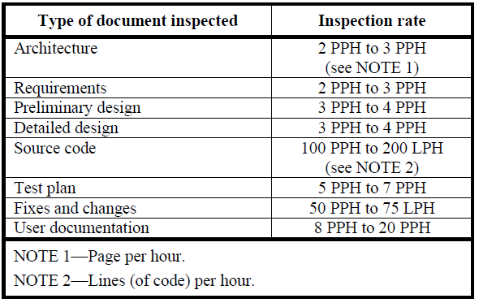
IEEE 1028 – Inspections
Measuring Rate of Inspection
Time Taken
Defects/Issues found
Fix Rate
Author Effectiveness
Reviewer Effectiveness

Slide 17
IEEE 1028 –
Products to be Reviewed
In Either Inspection or Walkthrough
Software requirements specification
Software design description
Source code
Software test documentation
Software user documentation
Maintenance manual
System build procedures
Installation procedures
Release notes
Software models
Specifications
Software development process descriptions
Policies, strategies, and plans
Marketing and publicity documents
Software architectural descriptions

Slide 18
When to Review
Product Launch Review
More of a Management review
Identify, review and ensure to have the milestone dates, requirements, schedule, budget constraints, deliverables, members of the development team, suppliers, etc.
Identify and define roles and responsibilities.
Review at the end of any Phase
Reviews should be done at the end of every phase.
Ensure that Entry criteria for next phase is met before entering the next phase
Retrospective Review (Also called as Post Mortem)
After the project is completed
What went well.
What could have been improved
Focus on Product and Process rather than Individual.
Report presented to Management
Learnings for the future Project.

Slide 19
Audits
Most formal type of Reviews
Provide an independent evaluation of conformance of software products and processes to applicable regulations, standards, guidelines, plans, specifications, and procedures.
Independent
Evaluation and conformance
Software Products and Processes
Applicable to
Regulations
Standards
Guidelines
Plans
Specification
Procedures

Slide 20
Types of Audits
Internal or First Party Audit
Conducted Internally by the organization itself
Can be used as self-declaration of conformity
Can focus on security and fraud detection
Identification of inefficiencies.
External
Second Party – Parties who have interest, like customers, suppliers, etc
Third Party – Independent auditing organizations
Regulators
Those providing certifications.

Slide 21
IEEE 1028 -
Audits Applicable to
Backup and recovery plans
Contingency plans
Contracts
Customer or user representative complaints
Disaster plans
Hardware performance plans
Installation plans
Installation procedures
Maintenance plans
Management review reports
Operations and user manuals
Procurement and contracting methods
Reports and data - Review, Audit, Project Status, Anomaly Reports, Test Data
Request for proposal
Risk management plans
Software configuration management plans
Software design descriptions
Source code
Unit development folders
Software project management plans
Software quality assurance plans
Software requirements specifications
Software safety plans
Software test documentation
Software user documentation
Software V&V plans
Software architectural descriptions
Standards, regulations, guidelines, plans, specifications, and procedures
System build procedures
Technical review reports
Vendor documents
Walk-through reports

Slide 22
IEEE 1028 – Audits
Roles and Responsibilities
Lead auditor
Preparing the audit plan
Assembling the audit team
Managing the audit team
Making decisions regarding the conduct of the audit
Making decisions regarding any audit observations
Preparing the audit report
Recommending corrective actions
Recorder
Document anomalies, action items, decisions, and recommendations made by the audit team.
Auditor(s)
Examine products, as defined in the audit plan.

Slide 23
IEEE 1028 – Audits
Roles and Responsibilities
Initiator
Decide upon the need for an audit
Decide upon the purpose and scope of the audit
Decide the software products or processes to be audited
Decide the evaluation criteria, including the regulations, standards, guidelines, plans, specifications, and procedures to be used for evaluation
Decide who will carry out the audit
Review the audit report
Decide what follow-up action will be required
Distribute the audit report
Audited organization
Provide a liaison to the auditors
Provide all information requested by the auditors.
Implement corrective actions and recommendations

Slide 24
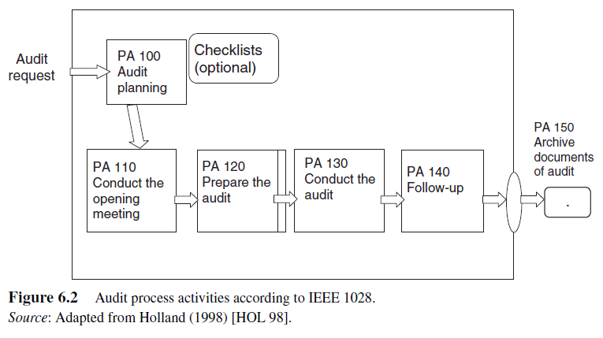
IEEE 1028 – Audit Steps

Slide 25
Audit as per CMMI-Dev
In the CMMI, audits are activities described as part of the “process and product quality assurance
To ensure objectivity, following issues must be addressed
Description of the reporting structure of the SQA to show its independence
Establish and maintain clearly formulated assessment criteria
What is going to be assessed?
When or how will the process be assessed?
How will the assessment be conducted?
Who must be involved in the assessment?
What product of an activity will be assessed?
When and how will the product of an activity be assessed?
Use the formulated criteria to assess the conformity of the -
Process descriptions
Standards
Procedures Executed

Slide 26
Project Assessment and Control Process
Purpose of Project Assessment and control
To assess if the plans are aligned and feasible
To determine the status of the project, technical and process performance
To Ensure that the performance is as per
Plans and Schedules,
Within projected budgets, and
Satisfies technical objectives.
To Conduct of management and technical reviews, audits, and inspections.

Slide 27
Corrective Actions (CA)
After an internal or external audit, an organization must perform CAs to correct the observed deficiencies
CMMI has a process area named “Causal analysis and resolution” to identify and eliminate root causes
Corrective Action -
Action to eliminate the cause of a nonconformity and to prevent recurrence.
Note 1: There can be more than one cause for a nonconformity.
Note 2: Corrective action is taken to prevent recurrence whereas preventive action is taken to prevent occurrence
ISO 9000 [ISO 15b]
An intentional activity that realigns the performance of the project work with the project management plan. PMBOK® Guide [PMI 13]
Preventive Action -
An intentional activity that ensures the future performance of the project work is aligned with the project management plan. PMBOK® Guide [PMI 13]

Slide 28
Corrective Actions (CA)
Process
Inputs:
An audit report
A non-compliance or a problem report
Activities:
Register non-conformities in the issue tracking tool
Analyze and validate the problem
Classify and prioritize the issue/problem
Propose a solution to the problem
Solve the problem and ensure that the resolution does not cause other problems,
Analyze the problems to conduct trend analysis that can be identified and addressed,
If it cannot be resolved within the project, refer it to the appropriate management level
Verify the problem resolution
Inform stakeholders of the problem resolution
Archive the problem documentation
Update the information in the issue tracking tool
Outputs
The resolution file
A corrected version of the software.

